Slide 1
Session 30
Networking
Notes:
Tp no did not match with the Session no. It was Tp no. 16 whereas the Session no. is 34

Slide 2
Review 2-1
The distributed object model used by Java allows objects in one JVM to invoke methods of objects in a separate JVM. These separate JVMs may execute as a different process in the same computer or on a remote computer.
The RMI system consists of three layers in its architecture, namely:
  The stub/skeleton layer
  The remote reference layer
  The transport layer
For implementing RMI, we need to implement RMI Server and then the RMI client. The steps involved in creating and registering a remote object are:
  Create the remote interface.
  Create a class that implements the remote interface.
  Create the stub and skeleton classes.
  Copy the remote interface and stub file to the client.
  Create and register the remote object.

Slide 3
Review 2-2
The RMI Server should be running before the client program is run. The tool used to create the stub and skeleton is rmic. The usage of rmic is as stated:
rmic packagename.classname
This creates two files, namely: classname_Stub.class and classname_Skel.class.
The Naming class is used to register and look up the remote object.

Slide 4
Objectives
Discuss applets and URLs
Explain Sockets
Explain Channels
Explore the java.net package
Discuss Applet-Applet Communication

Slide 5
Introduction
Communication plays a major role in every individual’s life.
Computers are the best means to communicate when it comes to global communication.
Computers on the Internet communicate using Transmission Control Protocol (TCP)/Internet Protocol (IP).
An IP address differentiates one PC from the other
  Example of an IP address : 205.20.167.177
Programs within the system communicate with each other using Ports.
Ports enable communication between programs.
Transmission Control Protocol (TCP) and User Datagram Protocol (UDP) are two such protocols.

Slide 6
Internet Address
The InetAddress class is used to encapsulate both numerical IP address and the domain name for the address.
The InetAddress has no constructors and to create an object of this class, one has to use the factory methods.
The three methods getLocalHost(), getByName() and getAllByName() can be used to create instances of InetAddress.

Slide 7
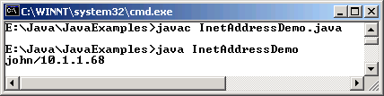
Example
import java.net.*;
class InetAddressDemo
{
public static void main(String [] args)
{
try
{
if(args.length > 0)
{
String host = args[0];
InetAddress [] address = InetAddress.getAllByName(host);
for(int i = 0; i < address.length; i++)
System.out.println(address[i]);
}
else
{
InetAddress localaddress = InetAddress.getLocalHost();
System.out.println(localaddress);
}
}
catch(Exception e)
{
e.printStackTrace();
}
}
}
Output

Slide 8




Using URLs with applets 2-1
Internet is made up of many networks
Resource 5
Uniform Resource Locator (URL)
Resource 4
Resource 1
Resource 3
Resource 2
Resource may be on any of these networks
Java applets help connect to various web sites
Client
Server

Slide 9
Using URLs with applets 2-2
Using Java applets, we can connect to various Web sites and browse or access the information.
Each Web site has a URL.
The java.net package contains a number of classes that implement browser-server connections.
A URL has two main components:
  Protocol Identifier- identifies the protocol to be used like http, ftp and so on.
  Resource name- is the complete address to the resource.
Protocol identifier and resource name are separated by a colon and two forward slashes.

Slide 10
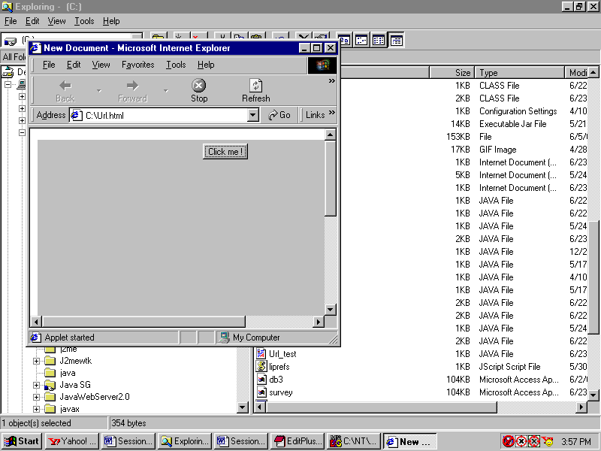
Example
import java.awt.FlowLayout;
import java.awt.event.*;
import java.net.*;
import javax.swing.JApplet;
import javax.swing.JButton;
public class UrlWindow extends JApplet implements ActionListener
{
JButton b;
URL url;
public void init()
{
url = null;
try
{
url = new URL("http://java.sun.com/products/archive/j2se/1.4.2_06");
}
catch (MalformedURLException e)
{
System.out.println("Malformed URL Exception Thrown");
}
b = new JButton ("Click me!");
setLayout(new FlowLayout());
add(b);
b.addActionListener(this);
}
public void actionPerformed(ActionEvent e)
{
if(e.getSource().equals(b))
{
getAppletContext().showDocument(url,"index.html");
}
}
}
Output

Slide 11
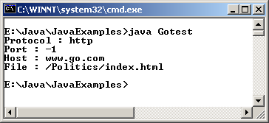
Example
Some of the methods of the URL class are used in the example.
import java.net.*;
class Gotest
{
public static void main(String [] args) throws MalformedURLException
{
URL hp = new URL("http://www.go.com/Politics/index.html");
System.out.println("Protocol : " + hp.getProtocol());
System.out.println("Port : " + hp.getPort());
System.out.println("Host : " + hp.getHost());
System.out.println("File : " + hp.getFile());
}
}
Output

Slide 12
Sockets
Each person connected through a telephone system is allotted a unique telephone number.
TCP service connects the sender and receiver in the case of Internet, using sockets.
Socket is a reference to communication links over a network with an application.
Sockets enable transfer of messages over a TCP/IP network and thus make it easy to develop custom client/server applications.
The two type of sockets are:
  TCP (Transfer Control Protocol) or IP (Internet Protocol)
  UDP (User Datagram Protocol)

Slide 13
Socket programming in Java
Sockets are often used in client/server applications in Java.
Java provides the following classes for socket programming:
  java.net.Socket
  java.net.ServerSocket
The Socket class is generally used for two-way socket communication.

Slide 14
Socket class constructors 3-1
Some of Socket class constructors are:
Method | Purpose
public Socket (String host, int port)throws UnknownHostException, IOException | This allows you to create a socket by specifying the domain name of the remote system in the form of a String and the port number as an int.
public Socket (InetAddress address, int port)throws IOException | This allows you to create a socket by specifying the IP address of the remote system and the port number.

Slide 15
Socket class constructors 3-2
Method | Purpose
public Socket (String host, int port, InetAddress localaddr, int localPort)throws IOException | Creates a socket by specifying the local interface, local port, IP address of the remote system and the remote port.
public Socket (InetAddress addr, int localport, boolean b )throws IOException | Creates a socket by specifying the IP address of the remote system and the local port. If the boolean argument b is true, it creates a stream socket; otherwise it creates a datagram socket.

Slide 16
ServerSocket class constructors
Some of ServerSocket class constructors are:
Method | Purpose
public ServerSocket (int port)throws IOException | Creates a listening socket at the given port. Default number of clients allowed to wait is 50.
public ServerSocket (int port, int count)throws IOException | Increases or decreases the number of waiting clients.
public ServerSocket (int port, int count, InetAddr localaddr)throws IOException | Increases or decreases the number of waiting clients and also specifies the local interface to listen for connections.

Slide 17
Example (OurSocket)
import java.net.*;
import java.io.*;
public class OurSocket
{
Socket socket;
BufferedReader theReader;
PrintWriter theWriter;
public OurSocket(String host, int port)throws UnknownHostException, IOException
{
this(new Socket(host, port));
}
public OurSocket(Socket s)throws UnknownHostException,
IOException
{
socket = s;
theReader = new BufferedReader(
new InputStreamReader(socket.getInputStream()));
theWriter = new PrintWriter(
socket.getOutputStream(), true);
}
public Socket getSocket()
{
return socket;
}
1
public void close()throws IOException
{
socket.close();
}
public String readLine()throws IOException
{
return theReader.readLine();
}
public void println(String s)throws IOException
{
theWriter.println(s);
}
}

Slide 18
Example (ServerWindow) 2-1
import java.net.*;
import java.io.*;
import java.util.*;
public class ServerWindow
{
public static final int PORT = 1234;
ServerSocket sst;
OurSocket os;
Vector morning = new Vector();
Vector night = new Vector();
public static void main(String [] args)
{
new ServerWindow().init();
}
public void init()
{
try
{
BufferedReader in;
String line;
in = new BufferedReader(new InputStreamReader(new FileInputStream("morning.txt")));
while ((line = in.readLine()) != null)
{
morning.addElement(line);
}
1
in.close();
in = new BufferedReader(new InputStreamReader(new FileInputStream("night.txt")));
while ((line = in.readLine()) != null)
{
night.addElement(line);
}
in.close();
sst = new ServerSocket(PORT);
while(true)
{
System.err.println("Here's the Server ... ready and running.");
os = new OurSocket(sst.accept());
String s = os.readLine();
System.out.println("Read " + s + " from client.");
Server Side

Slide 19
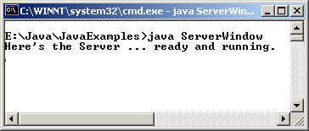
Example (ServerWindow) 2-2
if (s.equalsIgnoreCase("morning"))
{
send(morning);
}
else if (s.equalsIgnoreCase("night"))
{
send(night);
}
else
{
System.err.println("Invalid request: " + s);
}
os.close();
System.err.println("Finished processing !!");
}
}
catch(Exception ex)
{
ex.printStackTrace();
}
}
public void send(Vector v) throws IOException
{
int size = v.size();
2
for(int i = 0; i < 3; i++)
{
int n = (int) (Math.random() * size);
os.println((String) v.elementAt(n));
}
}
}
Server Side
Output

Slide 20
Example (ClientWindow) 2-1
import java.awt.*;
import java.awt.event.*;
import javax.swing.JApplet;
import javax.swing.JButton;
import javax.swing.JPanel;
import javax.swing.JScrollPane;
import javax.swing.JTextArea;
//<applet code=ClientWindow width=300 height=300></applet>
public class ClientWindow extends JApplet implements ActionListener {
JButton morningButton = new JButton("Morning");
JButton nightButton = new JButton("Night");
JTextArea message = new JTextArea(5,20);
JScrollPane scpArea;
OurSocket os;
public void init() {
setLayout(new BorderLayout());
JPanel p = new JPanel();
add(p, BorderLayout.NORTH);
scpArea = new JScrollPane(message);
add(scpArea, BorderLayout.SOUTH);
p.setLayout(new GridLayout(1, 0));
p.add(morningButton);
p.add(nightButton);
message.setEditable(false);
morningButton.addActionListener(this);
nightButton.addActionListener(this);
}
public void fatalError(Exception ex) {
ex.printStackTrace();
try {
os.close();
} catch (Exception ex1) {
System.out.println(ex1);
}
}
public void actionPerformed(ActionEvent e) {
message.setText("");
if(e.getSource() == morningButton) {
try {
message.setText("");
os = new OurSocket(getCodeBase().getHost(), 1234);
os.println("Morning");
message.append(os.readLine() + "\n");
message.append(os.readLine() + "\n");
message.append(os.readLine() + "\n");
os.close();
} catch (Exception ex) {
fatalError(ex);
}
1
Client side

Slide 21
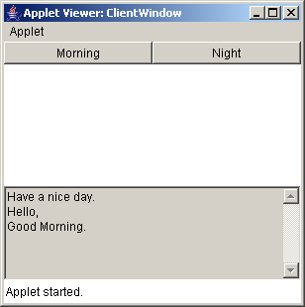
Example (ClientWindow) 2-2
} else {
try {
message.setText("");
os = new OurSocket(getCodeBase().getHost(), 1234);
os.println("Night");
message.append(os.readLine() + "\n");
message.append(os.readLine() + "\n");
message.append(os.readLine() + "\n");
os.close();
} catch (Exception ex) {
fatalError(ex);
}
}
}
}
Output
2
Client side

Slide 22
Datagram Packets
Applications that use datagram have to communicate by sending and receiving independent packets of information.
Clients and servers need not have any point – to – point connection.
Delivery and order of delivery of packets are not guaranteed.

Slide 23
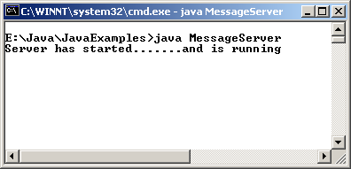
Example (MessageServer)
import java.io.*;
public class MessageServer
{
public static void main(String[] args)throws IOException
{
new MessageServerThread().start();
}
}
Output

Slide 24
Example (MessageServerThread) 2-1
import java.io.*;
import java.net.*;
import java.util.* ;
public class MessageServerThread extends Thread
{
protected DatagramSocket socket = null;
protected BufferedReader in = null;
protected boolean moreQuotes = true;
public MessageServerThread() throws IOException
{
this("MessageServerThread");
}
public MessageServerThread(String name) throws IOException
{
super(name);
socket = new DatagramSocket(4445);
try
{
in = new BufferedReader(new FileReader("message.txt"));
}
catch (FileNotFoundException e)
{
System.err.println("Could not open quote file.");
}
}
1
public void run()
{
while(moreQuotes)
{
try
{
byte[] buf = new byte[256];
// receive request into the byte array
DatagramPacket packet = new DatagramPacket(buf, buf.length);
socket.receive(packet);
// figure out response
String dString = null;
if (in == null)
dString = "No more Quotes";
else
dString = getNextQuote();
buf = dString.getBytes();
// sends the response to the client at
// "address" and "port", when the request came
// the address and the port is also attached
InetAddress address = packet.getAddress();
int port = packet.getPort();
Server Side

Slide 25
Example
(MessageServerThread) 2-2
packet = new DatagramPacket(buf, buf.length, address, port);
socket.send(packet);
}
catch (IOException e)
{
e.printStackTrace();
moreQuotes = false;
}
}
socket.close();
}
protected String getNextQuote()
{
String returnValue = null;
try
{
if ((returnValue = in.readLine()) == null)
{
in.close();
moreQuotes = false;
returnValue = "No more quotes. Goodbye.";
}
}
2
catch (IOException e)
{
returnValue = "IOException occurred in server.";
}
return returnValue;
}
}
Server Side

Slide 26
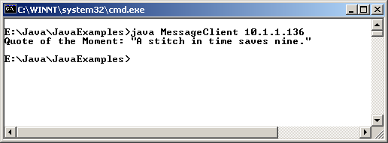
Example (MessageClient)
import java.io.*;
import java.net.*;
public class MessageClient
{
public static void main(String[] args)throws IOException
{
if(args.length != 1)
{
System.out.println("Use: java MessageClient <hostname>");
return;
}
String received;
// get a datagram socket
DatagramSocket socket = new DatagramSocket();
// send request
byte[] buf = new byte[256];
InetAddress address = InetAddress.getByName(args[0]);
DatagramPacket packet = new DatagramPacket(buf, buf.length, address, 4445);
socket.send(packet);
// get response
packet = new DatagramPacket(buf, buf.length);
socket.receive(packet);
// display response
received = new String(packet.getData());
if(received.trim().equals("No more quotes. Goodbye."))
System.out.println("No more quotes. Goodbye.");
else
System.out.println("Quote of the Moment: " + received.trim());
socket.close();
}
}
Client side
Output

Slide 27
Socket Channel
Socket Channels are different from File Channel.
The three socket channel classes (Datagram Channel, Socket Channel, ServerSocket Channel) extend from AbstractSelectableChannel
All socket channels create a peer socket object when they are instantiated.
Socket Channels can operate in non-blocking mode.

Slide 28
ServerSocketChannel
The ServerSocketChannel class is a channel based socket listener.
ServerSocketChannel is created with the open() method, which returns a channel associated with an unbound java.net.ServerSocket object.
Since ServerSocketChannel does not have a bind() method, it is necessary to obtain the peer socket and use it to bind to a port and begin listening for connections. The syntax is:
ServerSocketChannel ssc = ServerSocketChannel.open();
ServerSocket serversocket = ssc.socket();
Serversocket.bind( new InetSocketAddress(1234));

Slide 29
Example (ChannelAccept) 2-1
import java.nio.ByteBuffer;
import java.nio.channels.ServerSocketChannel;
import java.nio.channels.SocketChannel;
import java.net.InetSocketAddress;
public class ChannelAccept
{
public static final String GREET = "Hello i am going and joining the Aptech Team\r \n";
public static void main(String [] args)throws Exception
{
int port = 1234;
if (args.length >0)
{
port = Integer.parseInt (args [0]);
}
ByteBuffer buffer = ByteBuffer.wrap(GREET.getBytes());
ServerSocketChannel ssc = ServerSocketChannel.open();
ssc.socket().bind(new InetSocketAddress (port));
ssc.configureBlocking (false);
while(true)
{
System.out.println("Waiting for connections");
SocketChannel sc = ssc.accept();
if(sc == null)
{
Thread.sleep (2000);
}
else
{
System.out.println("Incoming connection: " + sc.socket().getRemoteSocketAddress());
buffer.rewind();
sc.write(buffer);
sc.close();
}
}
}
}

Slide 30
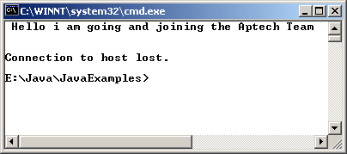
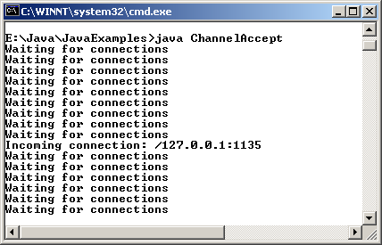
Example 2-2
Output

Slide 31
Socket Channel and Datagram Channel
A socket channel acts as a client initiating a connection with a listening server.
The calling of the socket() method on the SocketChannel will return a socket object.
The connect() method helps to connect the newly created Socket channel.
Every DatagramChannel object has an associated DatagramSocket object.
DatagramChannel models connectionless packet oriented protocols such as UDP / IP.
Datagram Channel object can act as both server and client.
Notes:
If ‘Pipes’ is a topic of consideration please add it in the slide.

Slide 32
Pipes
Pipes are found in java.nio.channels package.
The Pipe class creates two Channel objects that provide a loop back mechanism.
The advantage of using pipe is encapsulation.
It can also be used for testing.

Slide 33
Example 2-1
import java.nio.*;
import java.nio.channels.*;
import java.util.Random;
class ReadPipeDemo
{
public static void main(String [] args)throws Exception
{
// creates a writable channel around standard output
WritableByteChannel out = Channels.newChannel (System.out);
// starts the work and gets a read end of the channel
ReadableByteChannel in = startwork(10);
ByteBuffer buffer = ByteBuffer.allocate(100);
while(in.read(buffer) >= 0)
{
buffer.flip();
out.write (buffer);
buffer.clear();
}
}
// this method returns a Socket Channel or a File Channel instance
private static ReadableByteChannel startwork(int num)throws Exception
{
Pipe pipe = Pipe.open();
Working worker = new Working(pipe.sink(), num);
worker.start();

Slide 34
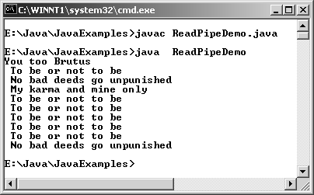
Example 2-2
return(pipe.source());
}
// a working thread object will write the data down the channel
private static class Working extends Thread
{
private String [] message = {
"No bad deeds go unpunished",
"To be or not to be",
"You too Brutus",
"My karma and mine only",
};
private Random rand = new Random();
WritableByteChannel channel;
private int num;
// creating a general Writable byte channel
Working(WritableByteChannel ch, int num)
{
this.channel = ch;
this.num = num;
}
// thread execution begins here
public void run()
{
ByteBuffer buffer = ByteBuffer.allocate(100);
try
{
for(int count =0; count < this.num; count++)
{
dowork(buffer);
while(channel.write(buffer) > 0)
{}
}
this.channel.close();
}
catch(Exception e)
{
e.printStackTrace();
}
}
private void dowork( ByteBuffer buffer)
{
int number = rand.nextInt(message.length);
buffer.clear();
buffer.put(message[number].getBytes());
buffer.put("\r\n ".getBytes());
buffer.flip();
}
}
}
Output

Slide 35
Applet-Applet communication
Instant communication is the buzzword of the day.
Medical emergencies is one of the examples where instant communication is essential to make decisions.
In Java, an applet can send message to another applet through:
  getAppletContext() method of the Applet class.
  getApplet() method of the AppletContext interface.

Slide 36
Example (FirstApplet)
import java.awt.*;
import java.applet.*;
public class FirstApplet extends Applet
{
TextArea text;
public void init()
{
text=new TextArea(" ");
add(text);
}
public void putText(String msg)
{
text.append(msg+"\n");
}
}

Slide 37
Example (SecondApplet)
import java.awt.*;
import java.applet.*;
import java.awt.event.*;
public class SecondApplet extends Applet implements ActionListener
{
TextField message;
AppletContext AppCon;
Button submit;
public void init()
{
message = new TextField(50);
add(message);
submit = new Button("Submit");
add(submit);
submit.addActionListener (this);
}
public void actionPerformed(ActionEvent e)
{
AppCon = getAppletContext();
FirstApplet ma = (FirstApplet)AppCon.getApplet("One");
if(ma!=null)
{
if(e.getSource().equals(submit))
{
ma.putText(message.getText());
message.setText(" ");
}
}
}
}

Slide 38
Example (test.html)
<html>
<applet code=SecondApplet width=400 height=400 name="Two">
</applet>
<applet code=FirstApplet width=400 height=400 name="One">
</applet>
</html>

Slide 39
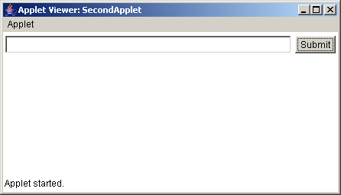
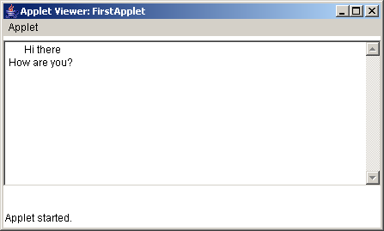
Example(Output)

Slide 40
Summary 2-1
An IP address is a 32-bit number written in decimal, hexadecimal or any other format and is used to distinguish one system from another during computer-computer communication.
Transport protocols are used to enable communication from one port to another.
TCP and UDP are two such protocols.
TCP is more commonly used than UDP.
The java.net package contains a number of classes that implement browser-server connections, the simplest among which is the URL class. The URL class encapsulates Web objects by their URL address.
A socket is a handle/reference to communication links over a network with an application.

Slide 41
Summary 2-2
Using sockets, we can send and receive messages over a TCP/IP network.
There are two types of sockets:
  TCP (Transfer Control Protocol) or Internet Protocol (IP) sockets.
  UDP (User Datagram Protocol)
Java provides the following classes for socket programming:
  java.net.Socket
  java.net.ServerSocket
The ServerSocket class allows you to bind a port and wait for the clients to connect.
Java supports Protocol handlers, also known as stream handlers. They are implemented as subclasses of URLStreamHandler class.

